Slide 1
Use of terms defined in the Avalanche Danger Scale (and Bavarian Matrix)
Norwegian Avalanche Forecasting Service
season 2014/2015
The forecasters at the Norwegian avalanche forecasting service set common terms for
additional loading, distribution, likelihood and avalanche size for each avalanche problem.
The following data is taken from the main avalanche problem in each bulletin over all
regions over the season 2014/2015 (until 28.04.2015).
Ragnar Ekker & Karsten Müller

Slide 2
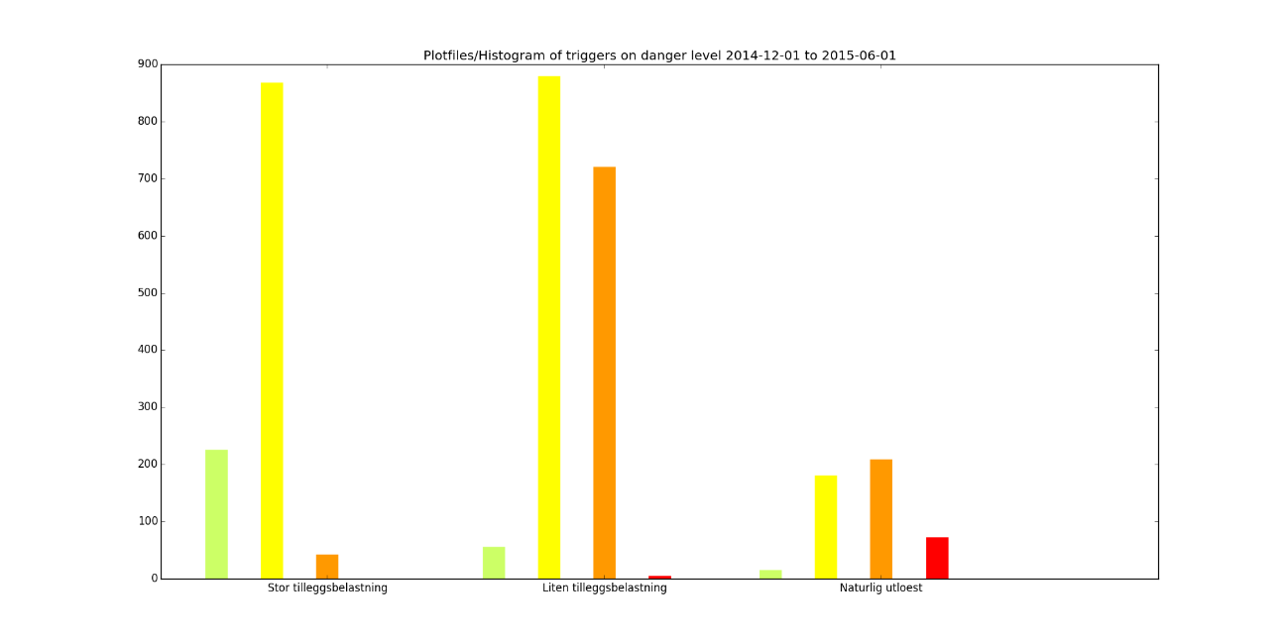
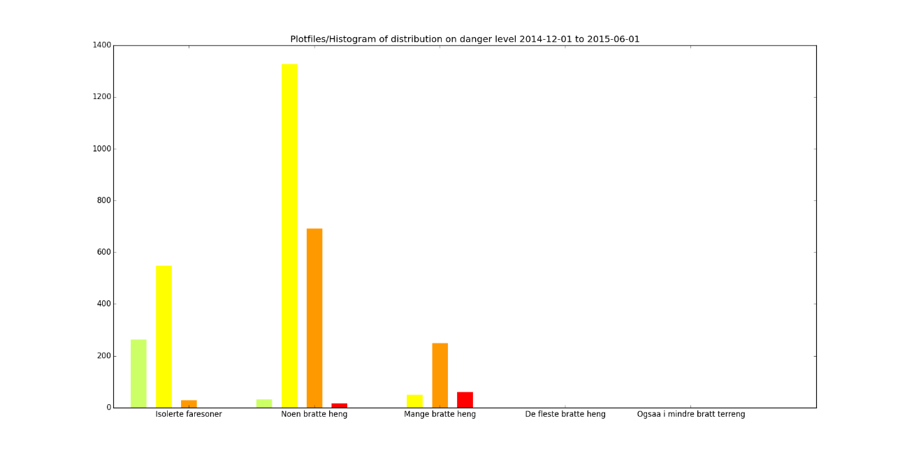
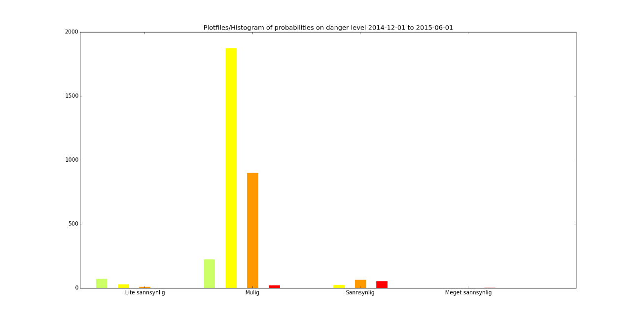
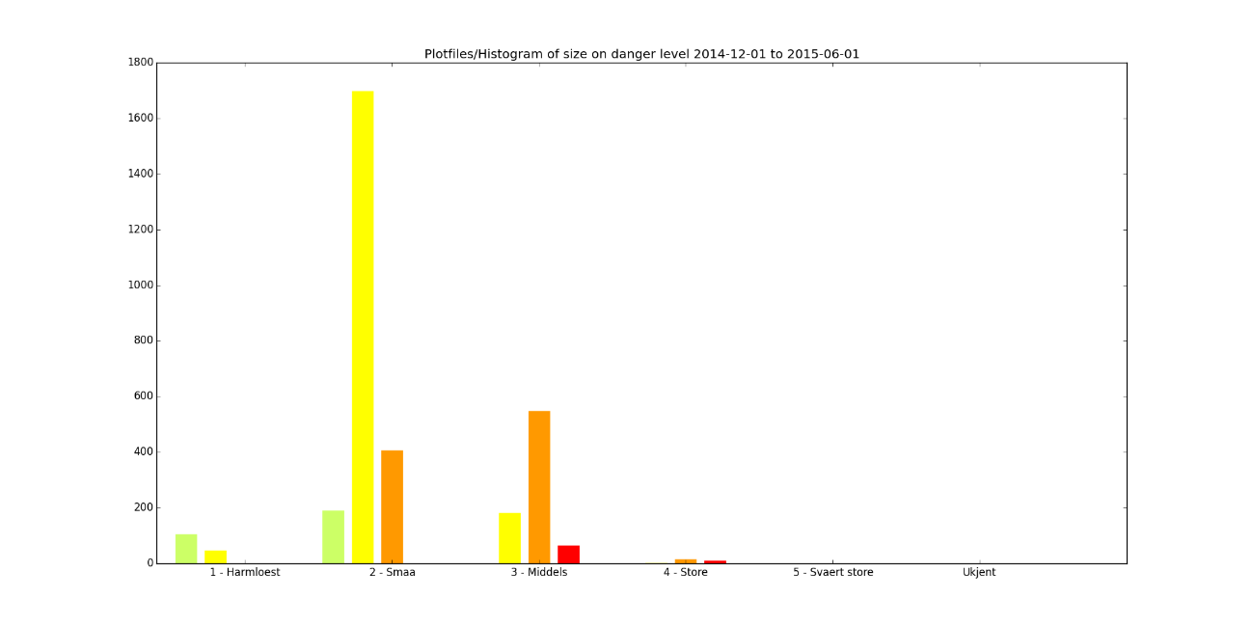
Trigger
Distribution
high
low
nat
isolated
some
most
many
Likelihood
Size
Unlikey
possible
likely
Very likely
1
2
3
4
5

Slide 3
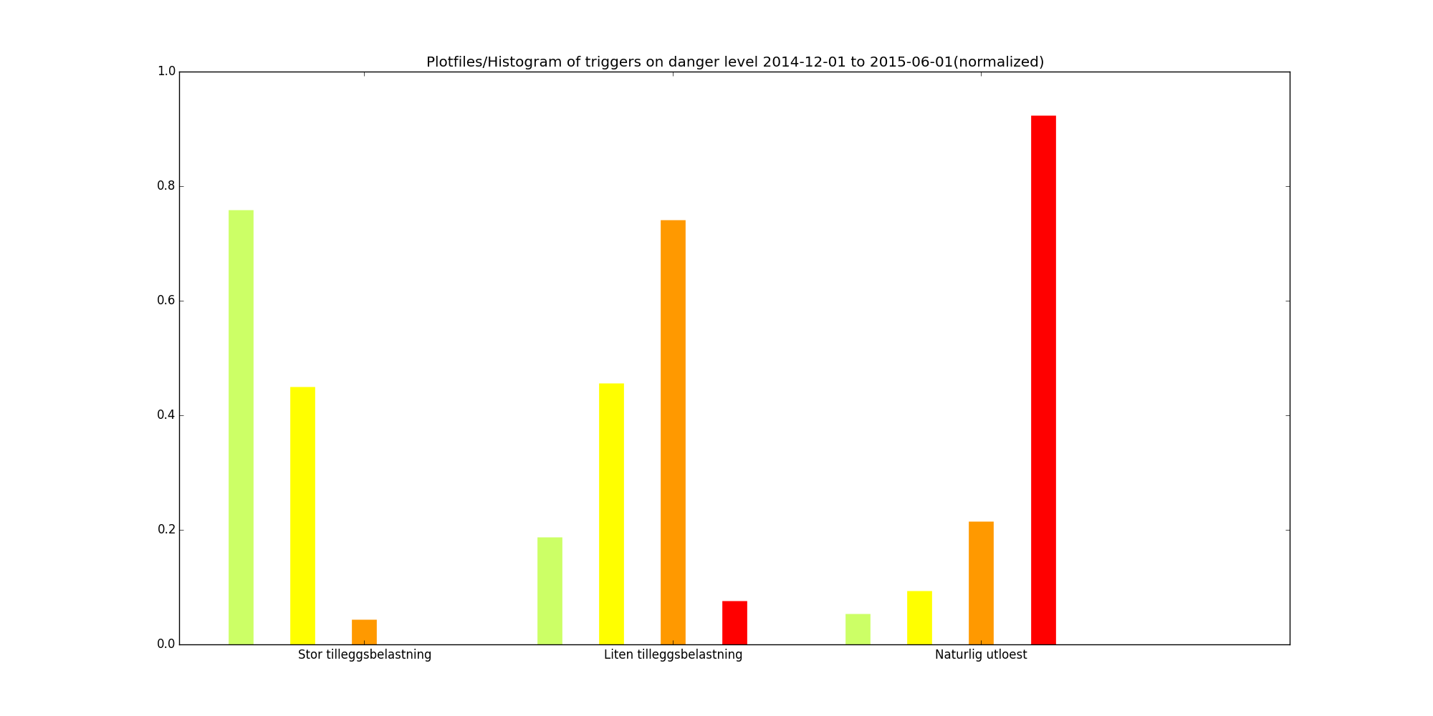
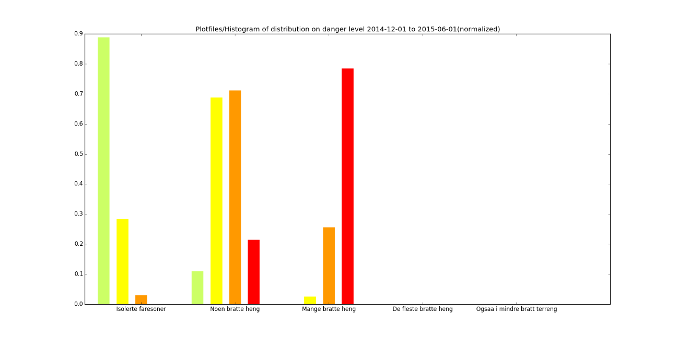
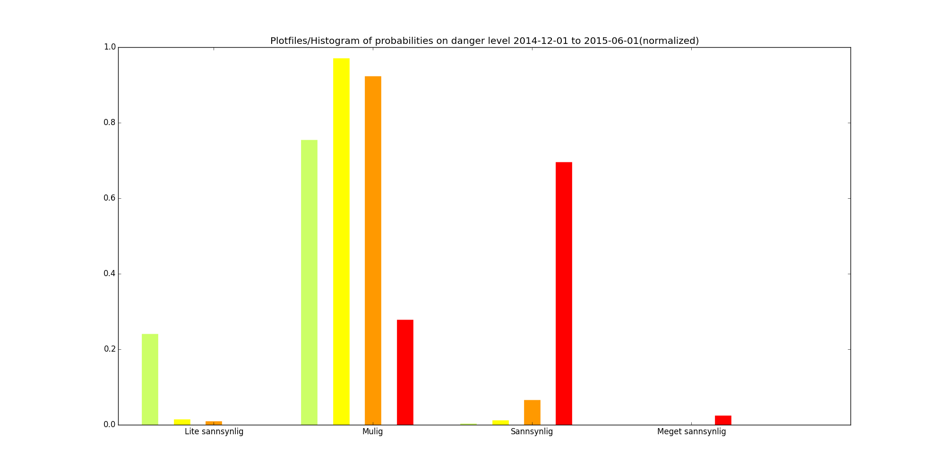
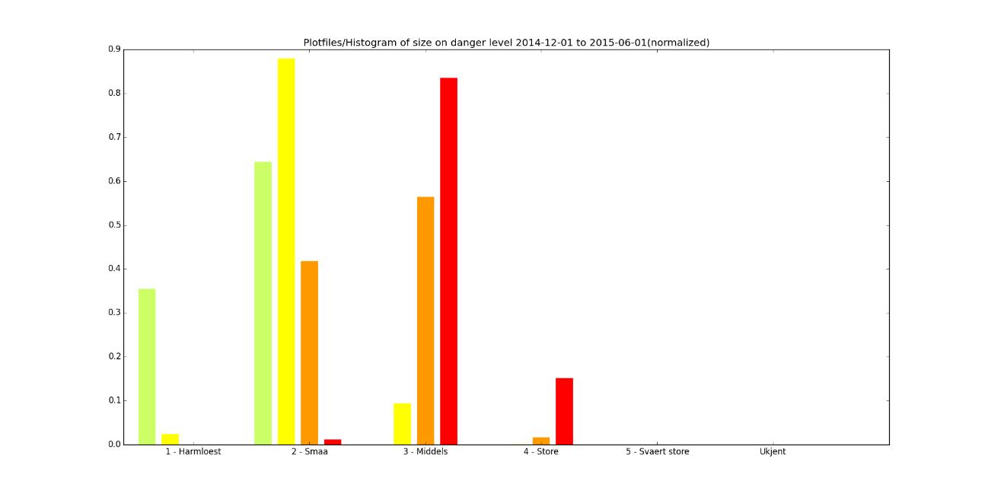
Trigger
Distribution
high
low
nat
isolated
some
many
most
Normalized by danger level
Likelihood
Size
Unlikey
possible
likely
Very likely
1
2
3
4
5

Slide 4
Patterns
Triggering
High additional load is rarely used at DL-3 and never at DL-4
Low additional load (LAL) is even used at DL-1
LAL is typical at DL-3
LAL is used in almost 50% of the DL-2 days
Natural triggering is mainly used at DL-4, but occurs at all levels
Distribution
Isolated is typical at DL-1, but also often used at DL-2
Some is commonly used at all DL
Many is typical for DL-4, but alos used at DL-3
Likelihood
Unlikely is mainly used at DL-1
Possible is most widely used and typically chosen at DL-2 and DL-3
Likely is typical for DL-4
Size
Size 4 is mainly used at DL-4
Size 3 is used at DL-3 and DL-4
Size 2 is generally most often used and typical for DL-2
The use of size 1 is mainly confined to DL-2

